Slide 1

Genre Classification: A Machine Learning Based Comparative Study of Classical Bengali Literature
Project Idea
Group No. 12
Asadullah Al Galib - 21266015
Satabdi Rani Debi - 22266016
Maisha Mostofa Prima - 22266007
Nayema Ahmed - 20101469
MD Muntasir Mahadi - 20101516
Adib Muhammad Amit - RA
Ehsanur Rahman Rhythm - ST

Slide 2
INTRODUCTION
Genre classification of Bengali Literature
Remarkable writers: Kazi Nazrul Islam, Rabindranath tagore, Bankim Chandra Chattopadhyay and Sarat Chandra Chattopadhyay
Classification Model- Naive Bayes
Deep Learning Model - LSTM, Transformer
Genres- Novel, Poem, Song, Story, Essay, Drama and others
Contrast and evaluate genres of ancient literature
Performance based accuracy

Slide 3
Related Works
Learning meters of Arabic and English poems with RNN
Trained character-level recurrent neural networks (RNN) on English and Arabic poems to identify meters for pronunciation
Book Genre Categorization Using Machine Learning Algorithms (K-Nearest Neighbor, Support Vector Machine and Logistic Regression) using Customized Dataset
Compared K-NN, SVM, and LR machine learning algorithms for classifying book genres
Genre Identification and the Compositional Effect of Genre in Literature
Developed genre identification methods using the Gutenberg Dataset and Compared deep learning models (CNN, LSTM, HAN) and traditional methods (Naive Bayes, k-Nearest Neighbors, Random Forests, XGBoost)
Statistical and Deep Learning Approaches for Literary Genre Classification.
Evaluated three machine learning (Random Forest, Naive Bayes, SVM) and four deep learning methods (LSTM, CNN, RNN, BERT) and SVM achieved 85% accuracy

Slide 4
METHODOLOGY
Naive Bayes:
Classification algorithm based on Bayes' theorem by Thomas Bayes in the 18th century.
Widely used for text classification tasks.
Probabilistic approach for classifying text data.
Feature Independence
Assumes feature independence for simplification.
Each feature impact is considered independently.
Text Categorization
Categorizes documents into predefined classes or categories.
Valuable for sentiment analysis, topic labeling, etc.
Multilingual Applications
Effective across languages like Hindi, Bengali, Turkish, Urdu.
Adaptable to different linguistic characteristics.

Slide 5
METHODOLOGY
Probability Calculation
Calculates conditional probabilities of class labels.
Determines the likelihood of document-class association.
Performance and Assumption
Despite feature independence assumption, often performs well.
Successful in categorization, sentiment analysis, and more.
Modern NLP and Conclusion
Remains relevant in modern NLP applications.
Key role in text classification due to simplicity and effectiveness.

Slide 6

METHODOLOGY
Long Short-Term Memory
LSTMs are designed to capture and retain long-range dependencies within sequential data, making them.
Gating mechanisms in LSTMs selectively capture dependencies within sequential data over time, enabling comprehension of intricate and prolonged dependencies.
LSTMs have expanded into sophisticated domains like machine translation and speech recognition due to their capacity to model intricate dependencies.
Long Short-Term Memory mainly excel in applications such as sentiment analysis, spam detection, and document categorization.

Slide 7
METHODOLOGY
Transformers
It finds applications in various fields, including sentiment analysis, news categorization, content moderation, and more.
Transformers, like BERT (Bidirectional Encoder Representations from Transformers), have revolutionized text classification.
Deep learning models, fueled by large-scale datasets, have transformed text classification by learning representations from unprocessed data, reducing the need for complex feature engineering
Transformers and their related pre-trained language models have become powerful tools in the most recent era of text classification.

Slide 8
Model Training of MNB
Data Preprocessing
Tokenization using NLTK for Bengali language
Removal of stopwords and digits
Joining preprocessed content into coherent documents
Feature Extraction
TF-IDF vectorization for numerical feature vectors
Learning vocabulary and IDF values from training data
Employed stratified sampling ('stratify=y') due to data imbalance
Hyperparameter Tuning
Grid Search with cross-validation
Hyperparameters: 'alpha' and 'fit prior' for MNB classifier
Model Training
MNB classifier trained using optimized hyperparameters

Slide 9
Result Analysis
Performance Metrics
Accuracy, Confusion Matrix, Class-wise Accuracy
Classification Report: Precision, Recall, F1-score, Support
Analysis
Nazrul:
Best Alpha: 0.01, Best Fit prior: True
Accuracy: 64.71%
Rabindranath:
Best Alpha: 0.01, Best Fit prior: True
Accuracy: 87.5%
Saratchandra:
Best Alpha: 1, Best Fit prior: True
Accuracy: 43.48%
For All Authors:
Best Alpha: 0.01, Best Fit prior: True
Accuracy: 84.44%
Higher accuracy observed with random state 42

Slide 10
Dataset Compilation
Compilation of 4 datasets.
Authors: Bankim, Nazrul, Rabindranath, Saratchandra.
Crawler is designed using “requests” and “beautifulsoup”.
Content hierarchy:
Collect all individual items inside each collection, inside each genre, for each author.
Aggregate, format, preprocess text files.
Create separate CSV and TXT files for each genre, for each author.
All datasets published on kaggle. 2 have received Bronze medals.
Challenges:
No uniform content layout
Broken pagination links
Ad-hoc starting page

Slide 11
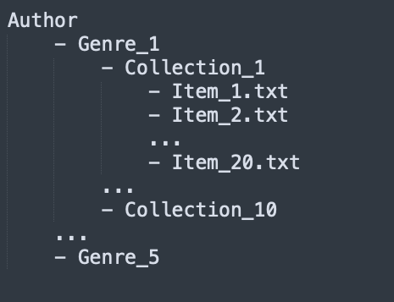
Dataset Compilation
Compilation of 4 datasets.
Authors: Bankim, Nazrul, Rabindranath, Saratchandra.
Crawler is designed using “requests” and “beautifulsoup” libraries.
Content hierarchy:
Collect all individual items inside each collection, inside each genre, for each author.
Aggregate, format, preprocess text files.
Create separate CSV and TXT files for each genre, for each author.
All datasets published on kaggle. 2 have received Bronze medals.
Challenges:
No uniform content layout
Broken pagination links
Ad-hoc starting page

Slide 12
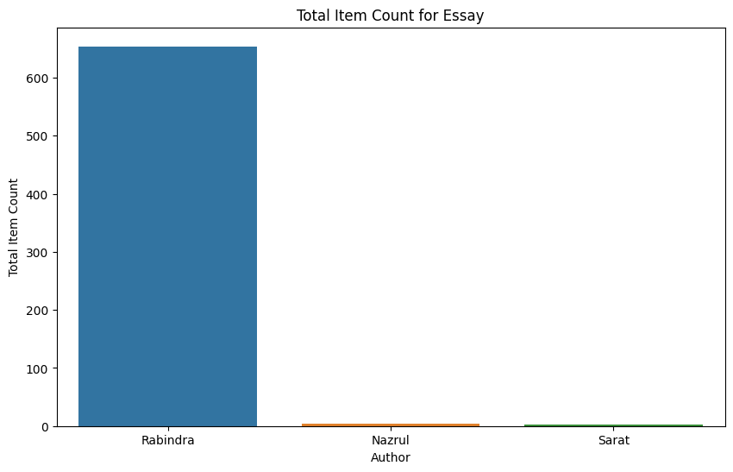
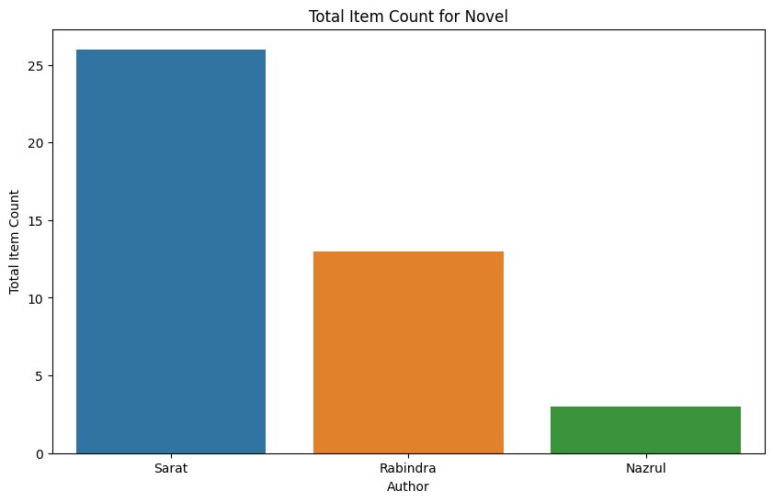
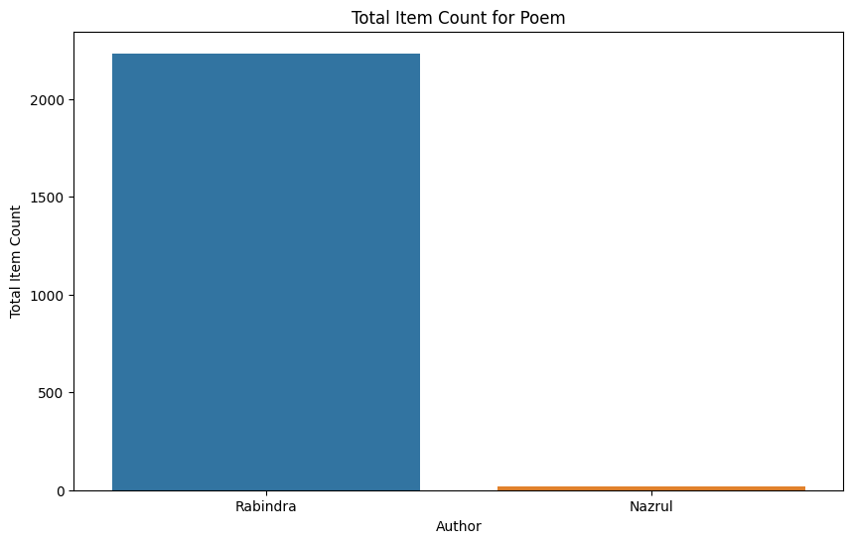
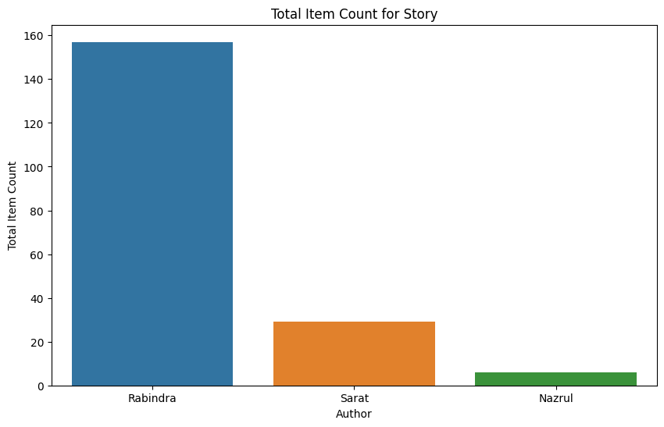

Slide 13
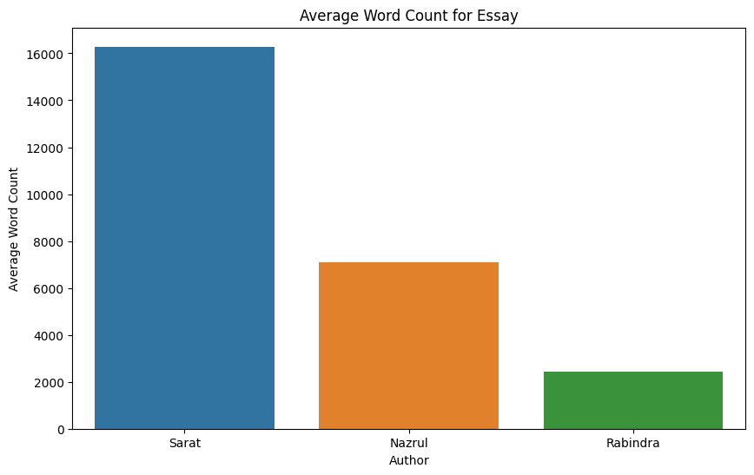
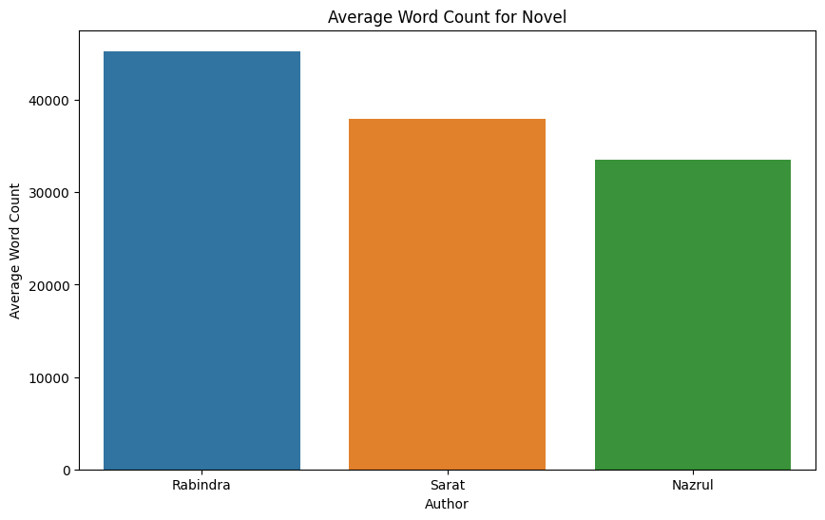
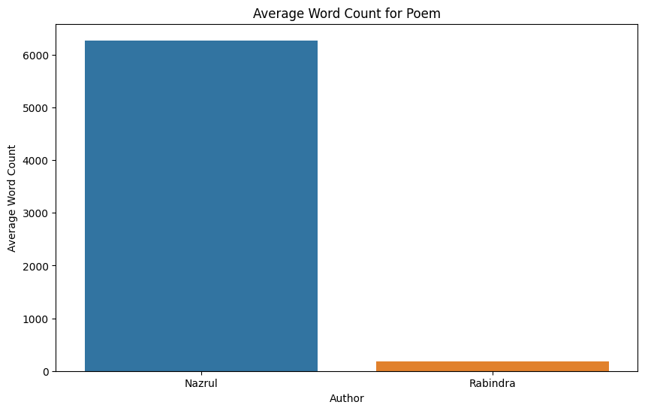
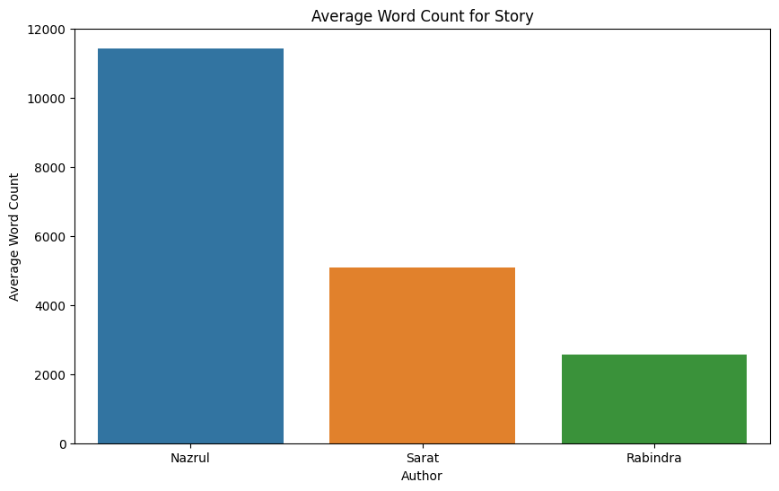

Slide 14
Pre-processing
Remove special symbols and punctuation.
Remove items from unwanted genres.
Contents are split using Bengali line-ending symbols, i.e. '।', '?', and '!' and then merged using different genre thresholds.
“Splitting & Merging” creates content of similar lengths.

Slide 15
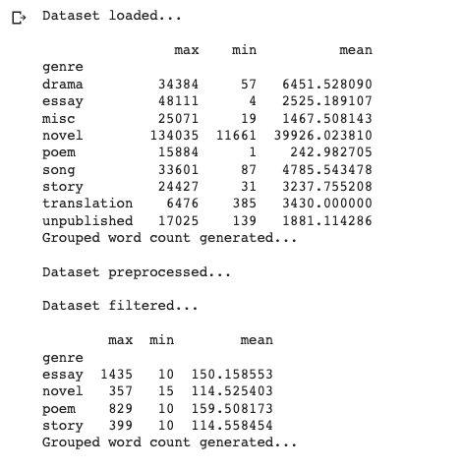
Pre-processing
Remove special symbols and punctuation.
Remove items from unwanted genres.
Contents are split using Bengali line-ending symbols, i.e. '।', '?', and '!' and then merged using different genre thresholds.
“Splitting & Merging” creates content of similar lengths.

Slide 16
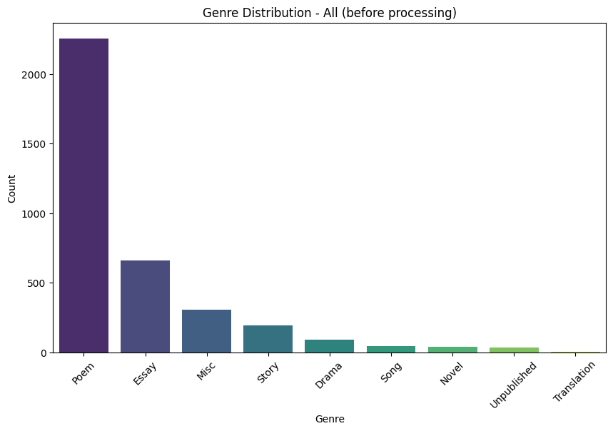
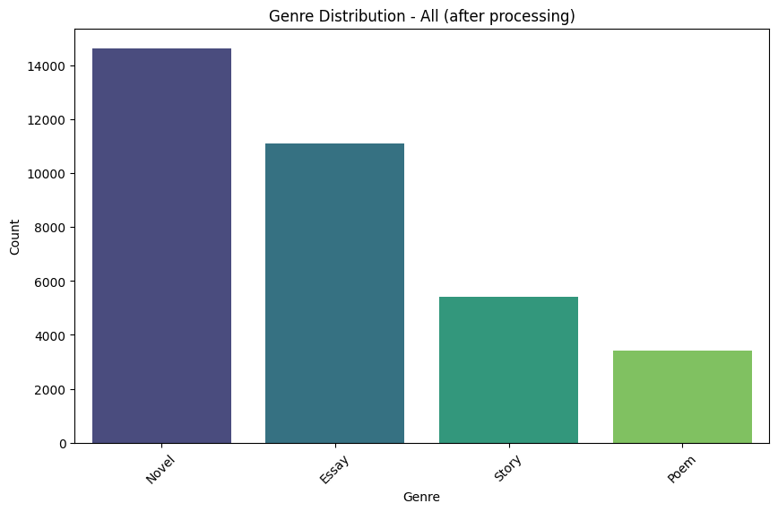
Pre-processing

Slide 17
Model Building & Training
Two types of DL models:
LSTM (Regular & Bi-directional)
Transformer-based Fine-tuned BERT
Three pre-trained language models are used:
Bangla-Electra
Bangla BERT Base
BERT Multilingual Base Model (Uncased)

Slide 18
Results
Parameters:
Learning-rate (0.001)
Max vocabulary size (50000)
Max sequence length (150)
Embedding dimension (300)
Number of LSTM units (64)
Batch size (32, 64)
Dropout layer (False)
Regularization (False)
Number of LSTM layers (3)
Bi-directional LSTM (True, False)
Number of epochs (50)

Slide 19
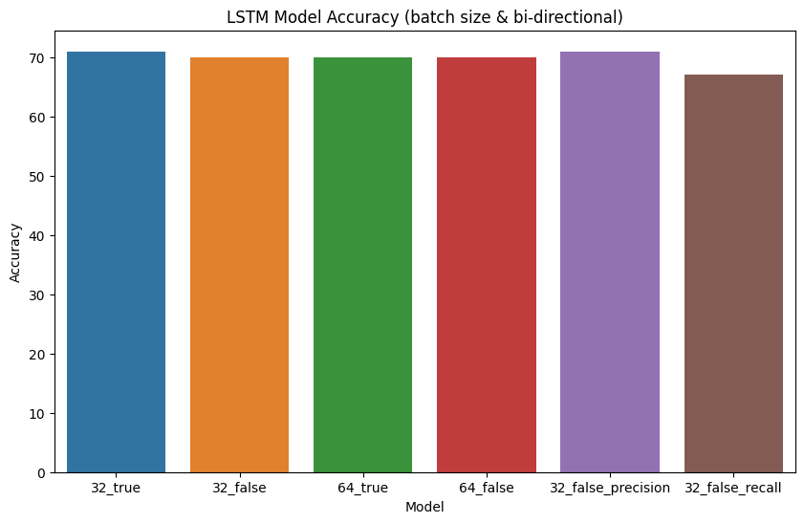
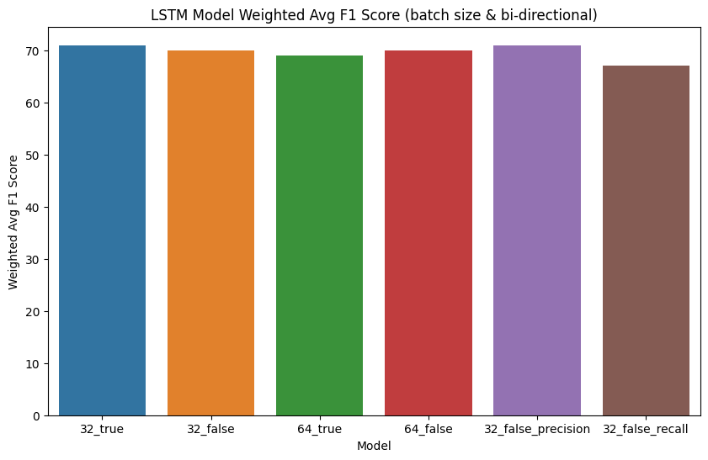
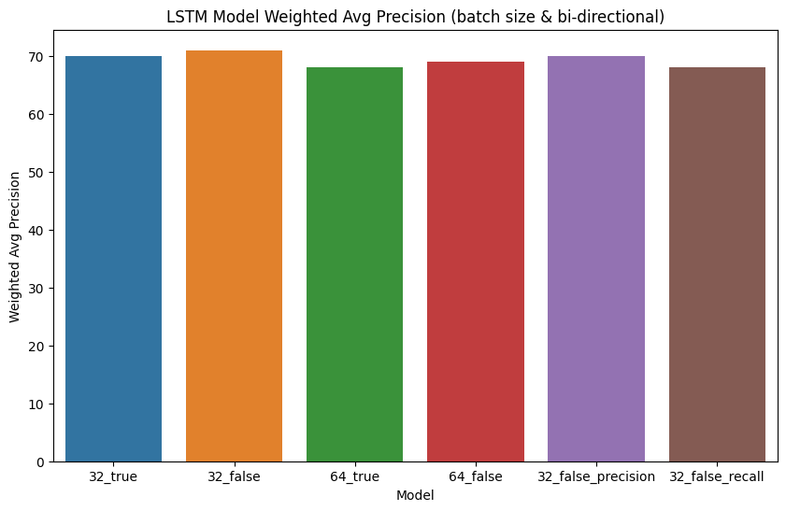
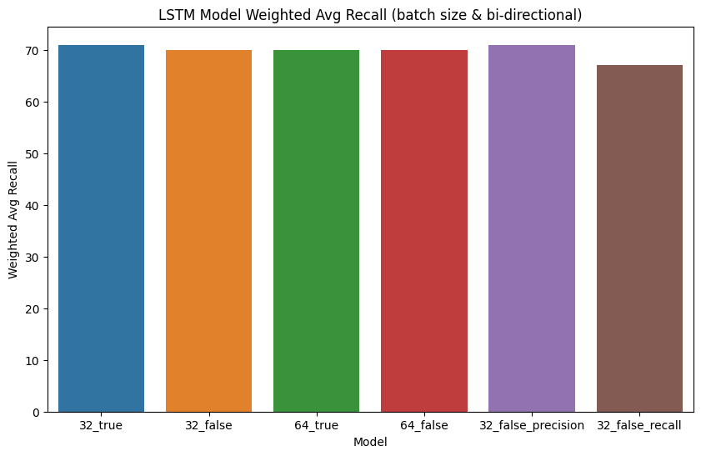

Slide 20
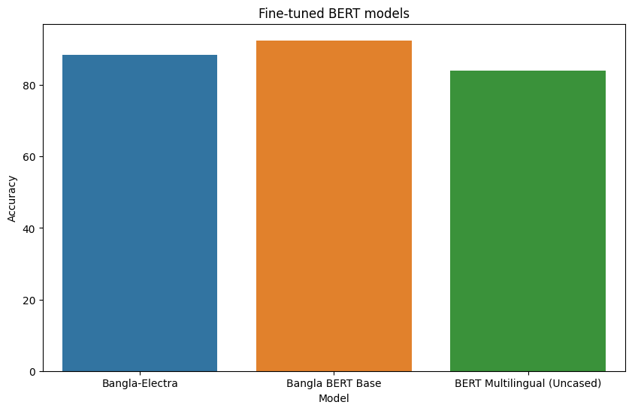

Slide 21
14% to 22% increase

Slide 22
Result Analysis
Different variants of LSTM and Bi-directional LSTM produced similar accuracy, precision, recall, and f1 scores.
Transformer-based BERT models produced much higher accuracy than simple LSTM models trained from scratch.
Pre-training played a significant role in downstream task, such as genre classification.
LSTM models - confused between story and novel genre

Slide 23
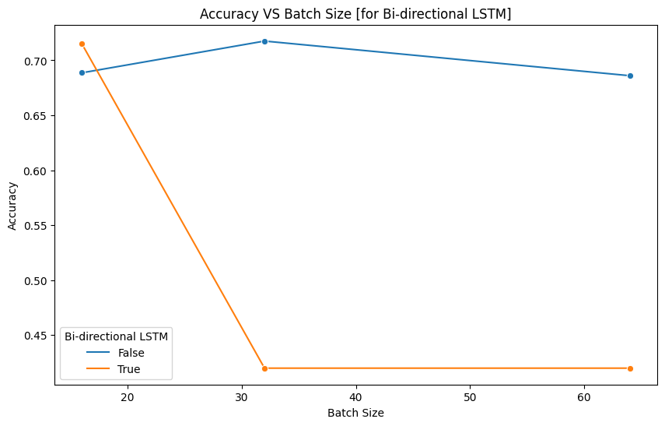
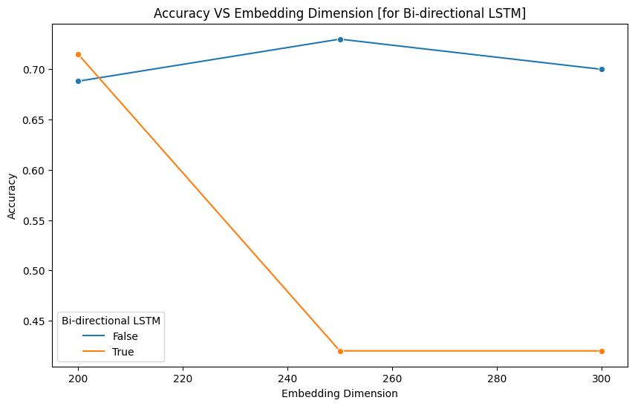
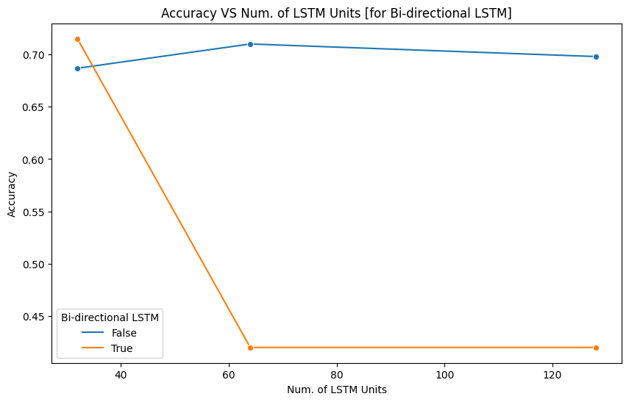
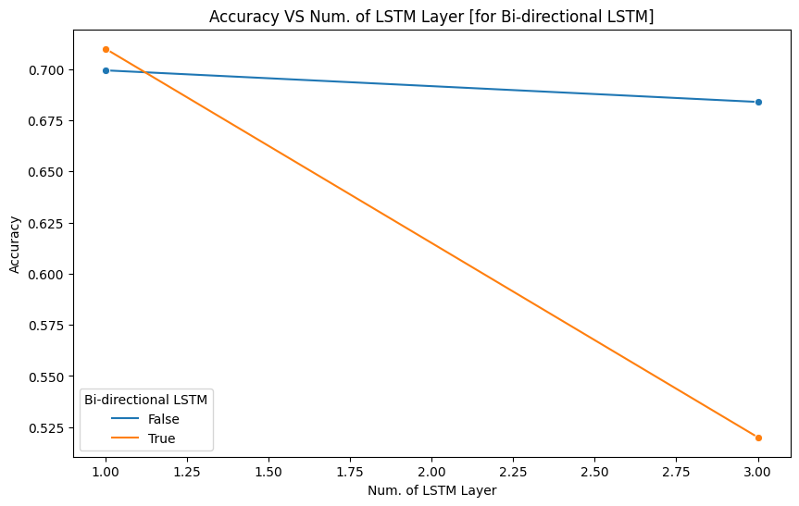
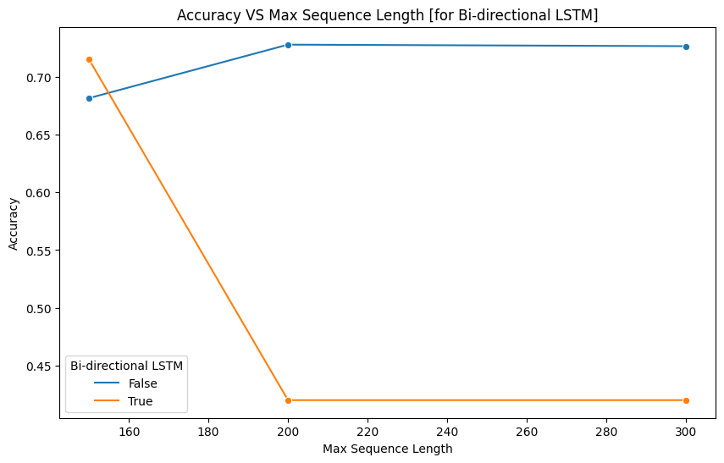
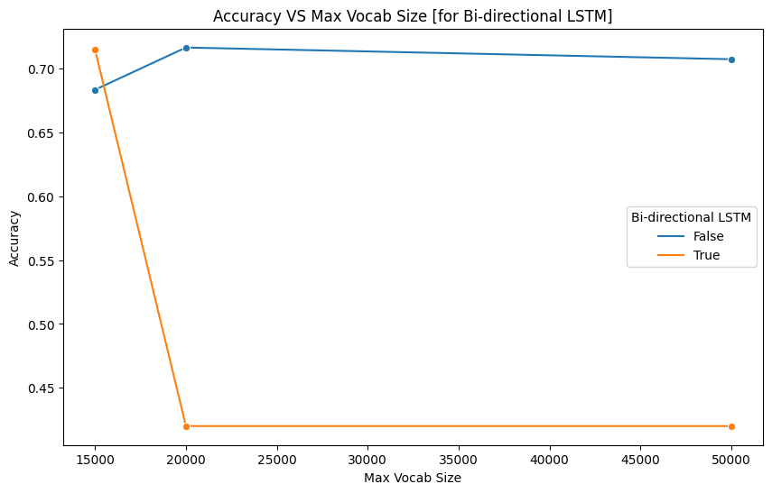

Slide 24
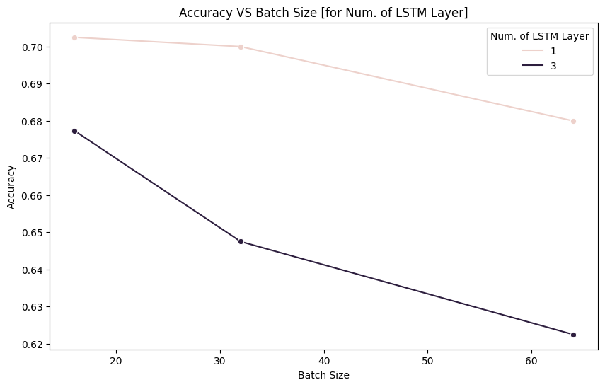
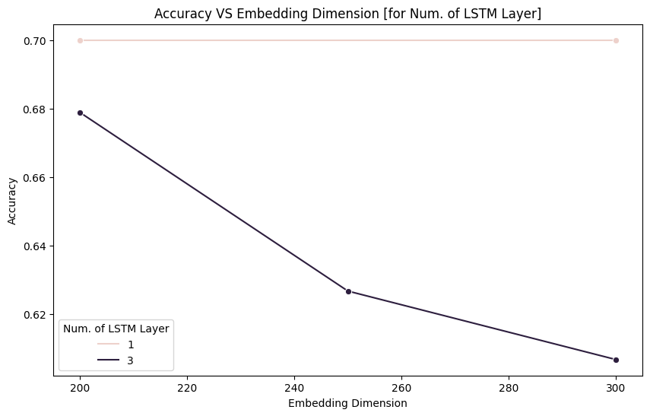
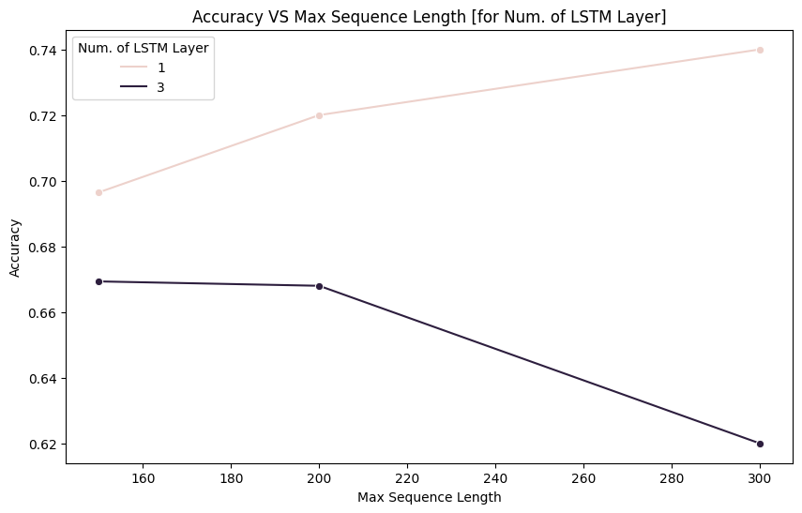
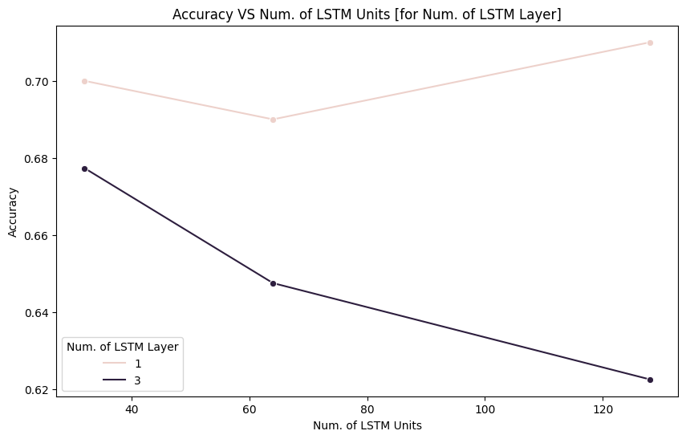
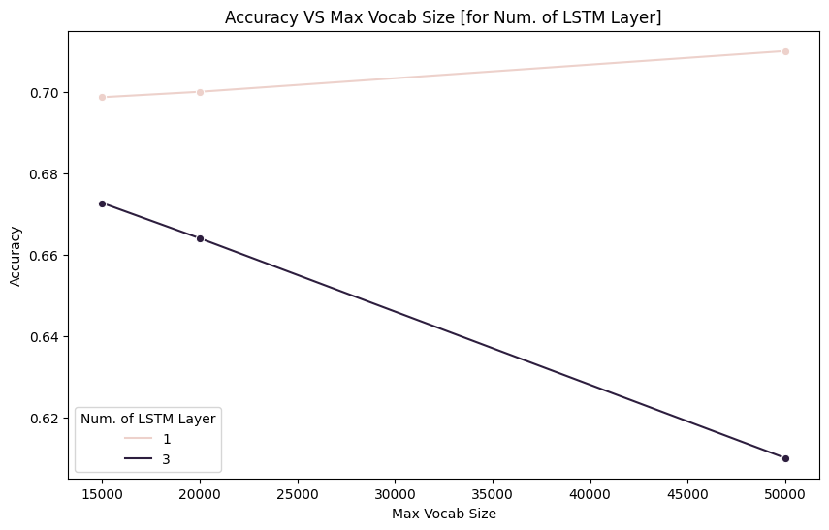

Slide 25
Future Works
Try more recent pre-trained language models, such as “MuRIL: Multilingual Representations for Indian Languages”
Conduct a more comprehensive hyperparameter tuning to exhaust all variables and measure model performance.

Slide 26
Conclusion
Compiled entire literary collections from 4 authors.
Genre classification using simple classical method as well as deep learning approach.
Transformer-based models produced much better results.

Slide 27
Q&A

Slide 28
References:
https://commoncrawl.org/
Kakwani, D., Kunchukuttan, A., Golla, S., Gokul, N. C., Bhattacharyya, A., Khapra, M. M., & Kumar, P. (2020, November). IndicNLPSuite: Monolingual corpora, evaluation benchmarks and pre-trained multilingual language models for Indian languages. In Findings of the Association for Computational Linguistics: EMNLP 2020 (pp. 4948-4961).
https://www.kaggle.com/aagalib/datasets
https://rabindra-rachanabali.nltr.org/node/16140
https://huggingface.co/monsoon-nlp/bangla-electra
https://huggingface.co/sagorsarker/bangla-bert-base
https://huggingface.co/bert-base-multilingual-uncased
Clark, K., Luong, M. T., Le, Q. V., & Manning, C. D. (2020). Electra: Pre-training text encoders as discriminators rather than generators. arXiv preprint arXiv:2003.10555.

